Slide 1

8th Grade Math: Pre-Algebra
Unit 8, Lesson 7 Introduction to Systems of Two Linear Equations Volume 2, pg. 33

Slide 2


Benchmarks
MA.8.AR.4.1
Given a system of two linear equations and specified set of possible solutions, determine which ordered pairs satisfy the system of linear equations.
MA.8.AR.4.2
Given a system of two linear equations represented graphically on the same coordinate plane, determine whether there is one solution, no solution, or infinitely many solutions.
volume 2, pg. 33

Slide 3
Integrated Mathematical Thinking and Reasoning Standards
MA.K12.MTR.1.1 Actively participate in effortful learning both individually and collectively.
MA.K12.MTR.5.1 Use patterns and structure to help understand and connect mathematical concepts.
volume 2, pg. 33

Slide 4

Learning Targets
I can relate equations with variables on both sides to two variable linear equations.
I can relate the solution to an equation with variables on both sides to the point of intersection on a graph.
volume 2, pg. 33

Slide 5

Warm-Up
volume 2, pg. 34

Slide 6
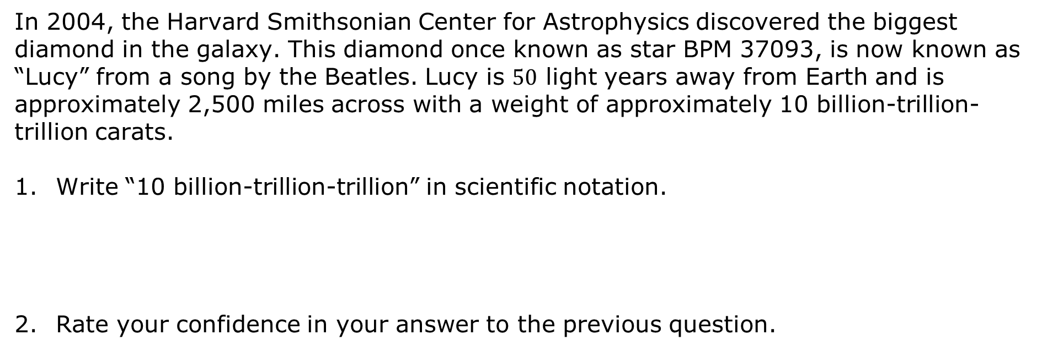
8.7.1 Warm-Up: Diamond in the Sky
In 2004, the Harvard Smithsonian Center for Astrophysics discovered the biggest diamond in the galaxy. This diamond once known as star BPM 37093, is now known as “Lucy” from a song by the Beatles. Lucy is $50$ light years away from Earth and is approximately 2,500 miles across with a weight of approximately 10 billion-trillion-trillion carats.
Write “10 billion-trillion-trillion” in scientific notation.
Rate your confidence in your answer to the previous question.
volume 2, pg. 34

Slide 7

Exploration
volume 2, pg. 34

Slide 8

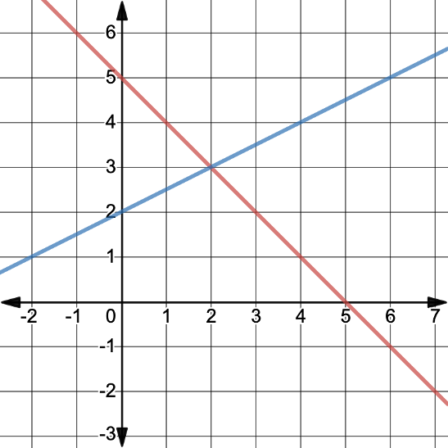
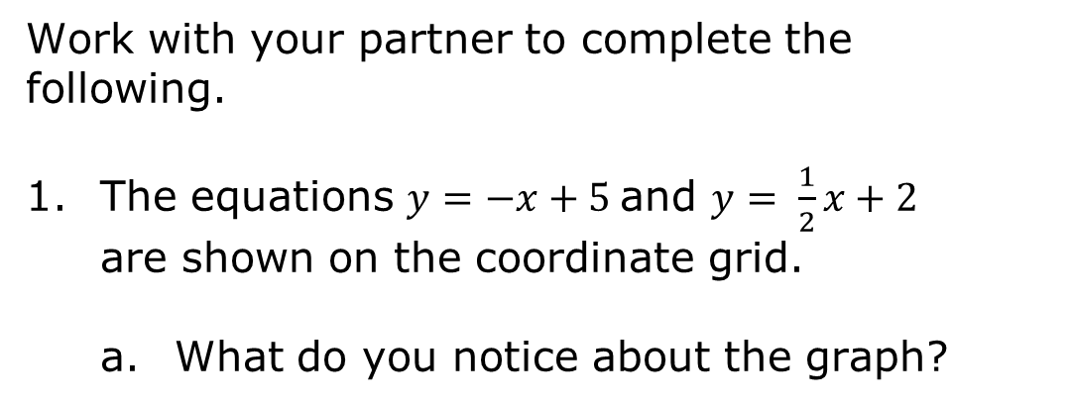
8.7.2 Exploration: Systems of Linear Equations
Work with your partner to complete the following.
The equations $y=−x+5$and $y= \frac{1}{2}x+2$ are shown on the coordinate grid.
What do you notice about the graph?
volume 2, pg. 34

Slide 9
Use the definition to explain why the graph is a system of equations.
Discuss with your partner what the quote from the definition, “The solution is the values for the variables that make all equations in the system true” means. Summarize your answer.
A system of equations is a set of two or more equations. Each equation contains two or more variables. The solution is the values for the variables that make all equations in the system true.
volume 2, pg. 34

Slide 10
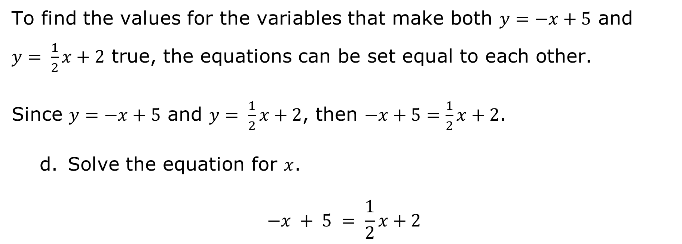
To find the values for the variables that make both $y=−x+5$ and
$y= \frac{1}{2}x+2$ true, the equations can be set equal to each other.
Since $y=−x+5$ and $y= \frac{1}{2}x+2$, then $−x+5=\frac{1}{2}x+2$.
Solve the equation for $x$.
$$−x + 5 = \frac{1}{2}x+2$$
volume 2, pg. 35

Slide 11

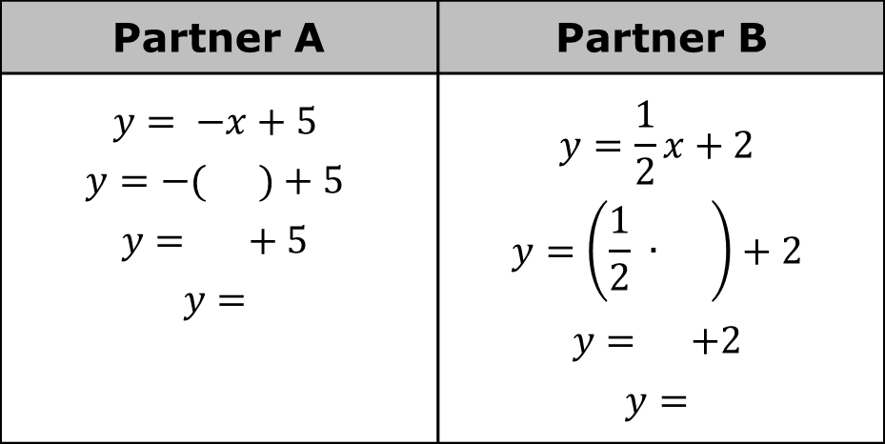
The solution only gives the $x$-value.
Decide who will be Partner A and who will be Partner B. Each partner uses the provided work to substitute the value of $x$ into one of the equations to find $y$.
Verify the $y$-value with your partner.
Partner A | Partner B
$$y= −x+5$$ $$y=−( )+5$$ $$y= + 5$$ $$y=$$ | $$y=\frac{1}{2}x+2$$ $$y=\left(\frac{1}{2} ∙ \right)+2$$ $$y= +2$$ $$y=$$
volume 2, pg. 35

Slide 12
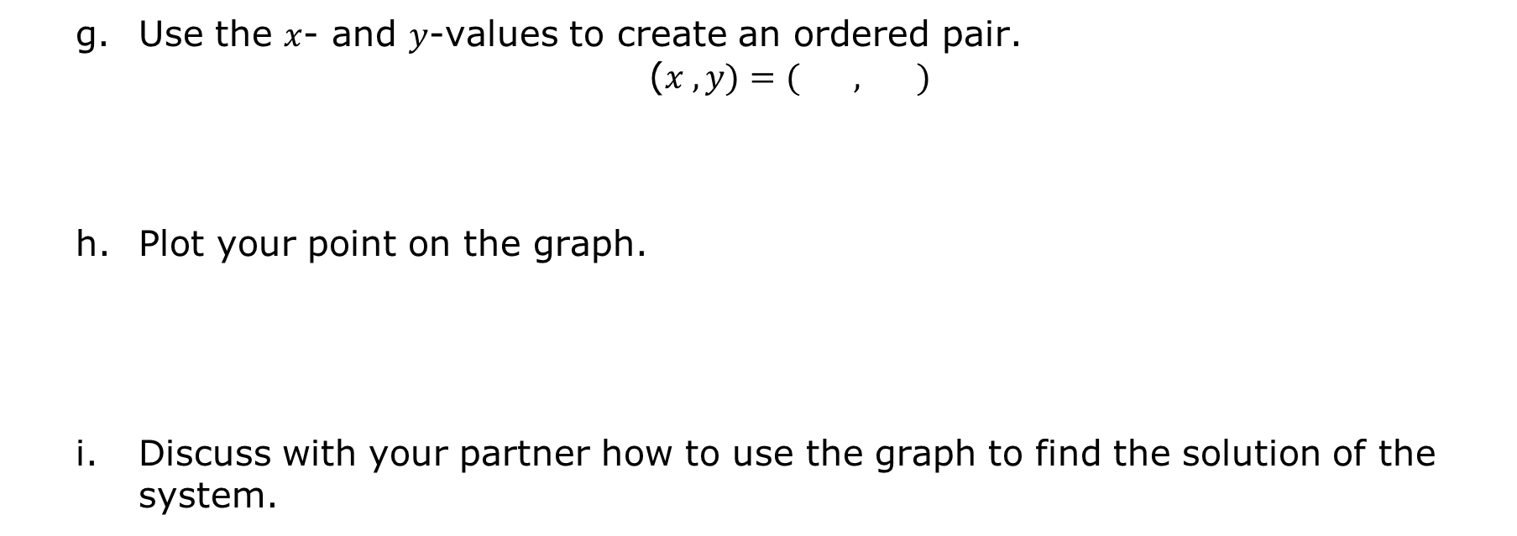
Use the $x$- and $y$-values to create an ordered pair.
($x , y)=( , )$
Plot your point on the graph.
Discuss with your partner how to use the graph to find the solution of the system.
volume 2, pg. 35

Slide 13
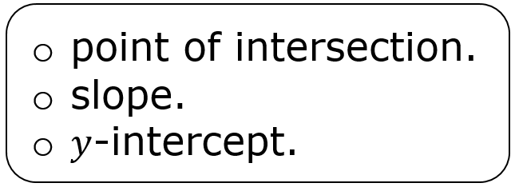
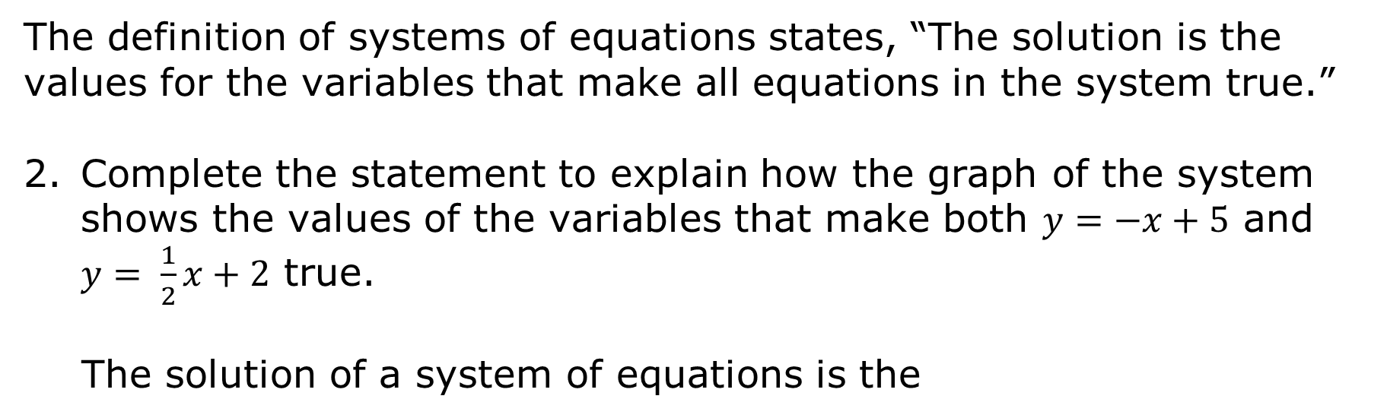
The definition of systems of equations states, “The solution is the values for the variables that make all equations in the system true.”
Complete the statement to explain how the graph of the system shows the values of the variables that make both $y=−x+5$ and $y= \frac{1}{2}x+2$ true.
The solution of a system of equations is the
volume 2, pg. 35

Slide 14

Guided Instruction
volume 2, pg. 36

Slide 15
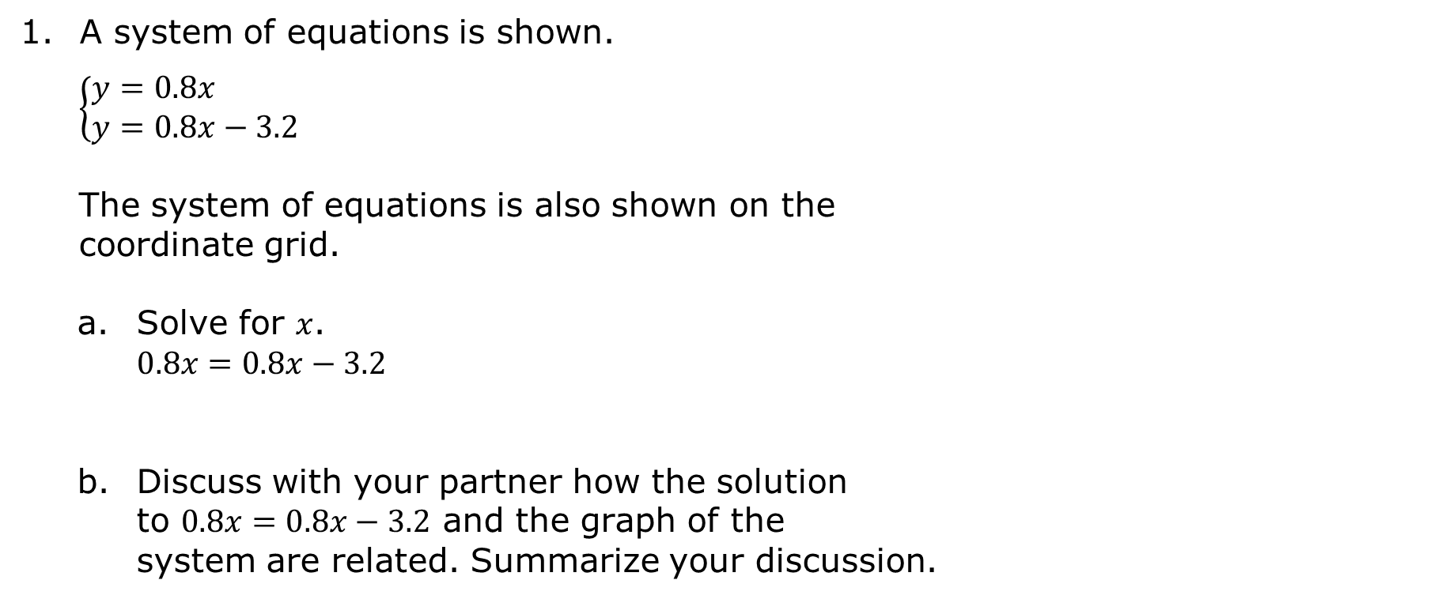
8.7.3 Guided Instruction: Solving Linear Systems
A system of equations is shown.
$$\left\{\begin{aligned}&y=0.8x \\ &y=0.8x−3.2\end{aligned}\right.$$
The system of equations is also shown on the coordinate grid.
Solve for $x$. $0.8x=0.8x−3.2$
Discuss with your partner how the solution to $0.8x=0.8x−3.2$ and the graph of the system are related. Summarize your discussion.
volume 2, pg. 36

Slide 16
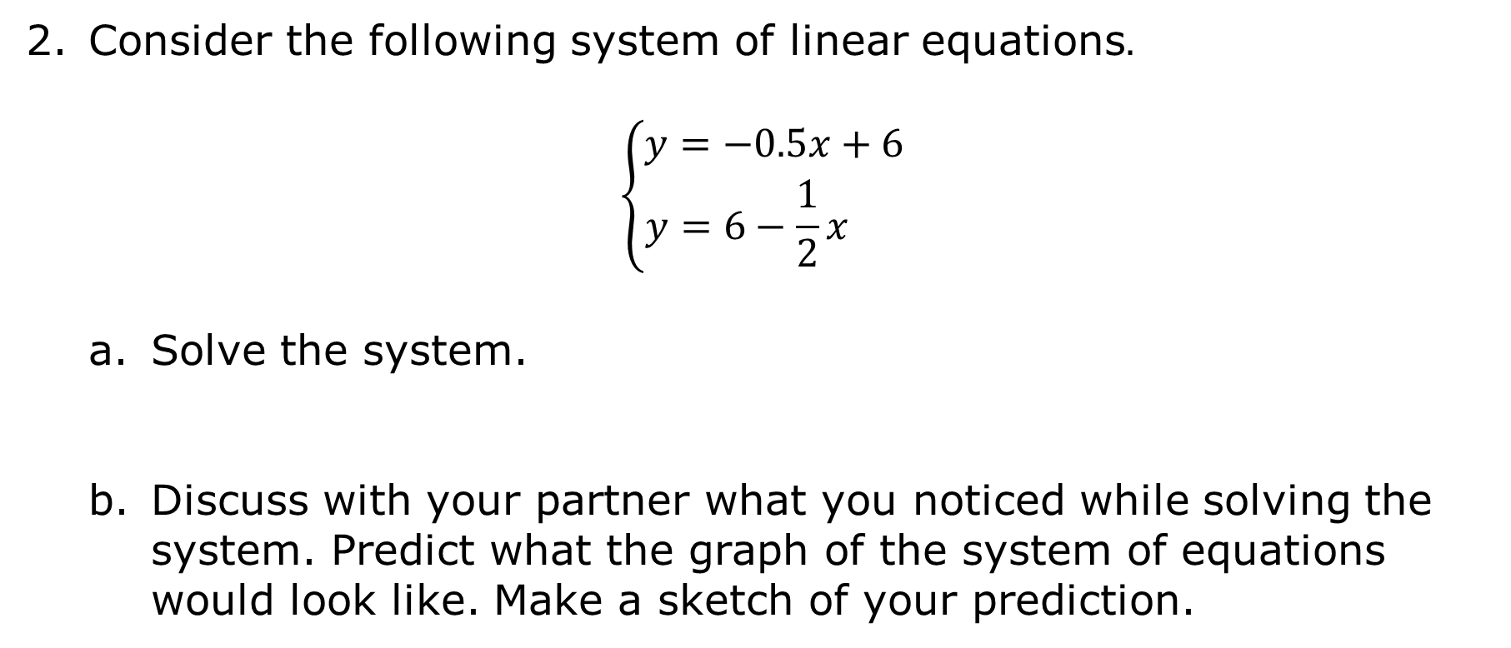
Consider the following system of linear equations$.$
$$\left\{\begin{aligned}y=−0.5x+6 \\ y=6−\frac{1}{2}x \end{aligned}\right.$$
Solve the system.
Discuss with your partner what you noticed while solving the system. Predict what the graph of the system of equations would look like. Make a sketch of your prediction.
volume 2, pg. 36

Slide 17
Ask a classmate what they noticed and their prediction. Record their observation and write your summary of their reason. You are the only person who should write in the first two columns of the table. Have the person initial next to your summary stating that your summary was correct.
Notice | My Summary of Their Reason | Initials
Predicted Graph | My Summary of Their Reason | Initials
volume 2, pg. 37

Slide 18

The graph of $y=6−\frac{1}{2}x$ is given.
Graph $y=−0.5x+6$ on the same coordinate plane.
volume 2, pg. 37

Slide 19
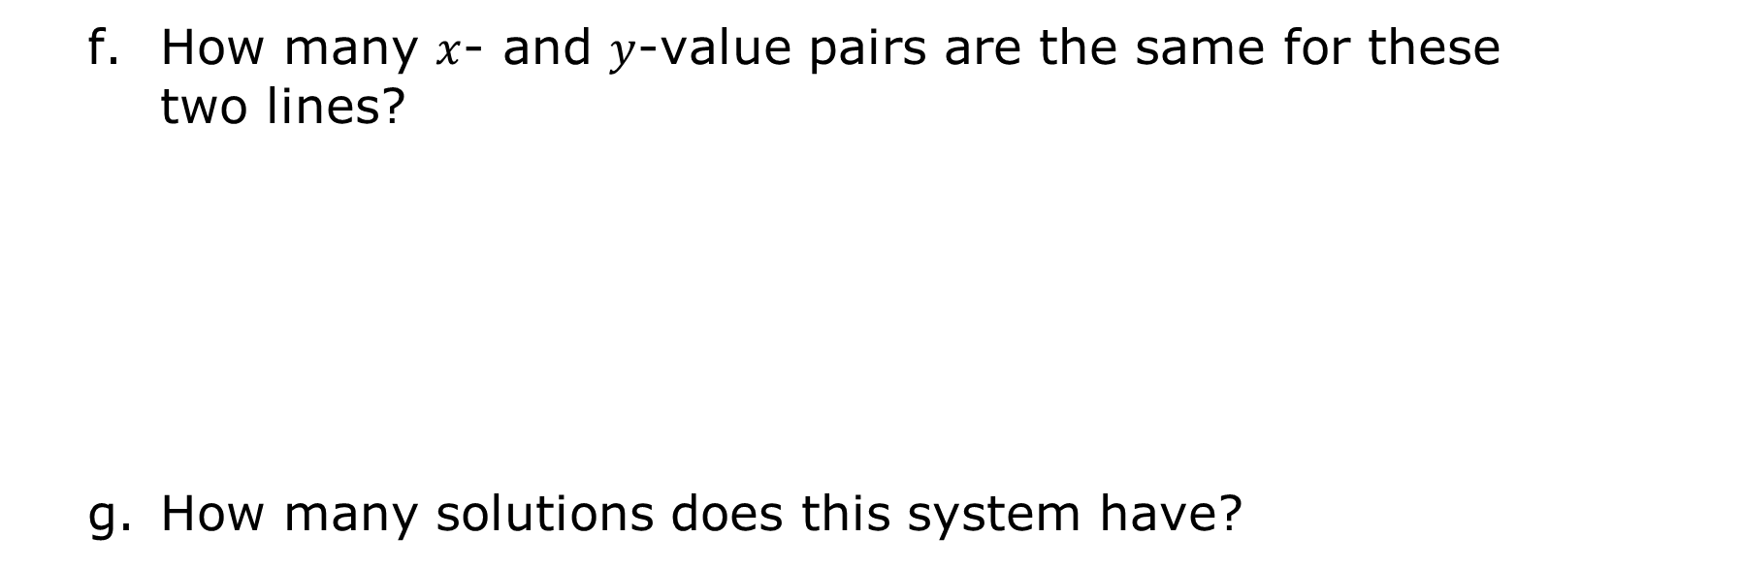
How many $x$- and $y$-value pairs are the same for these two lines?
How many solutions does this system have?
volume 2, pg. 37

Slide 20

Wrap-Up
volume 2, pg. 38

Slide 21
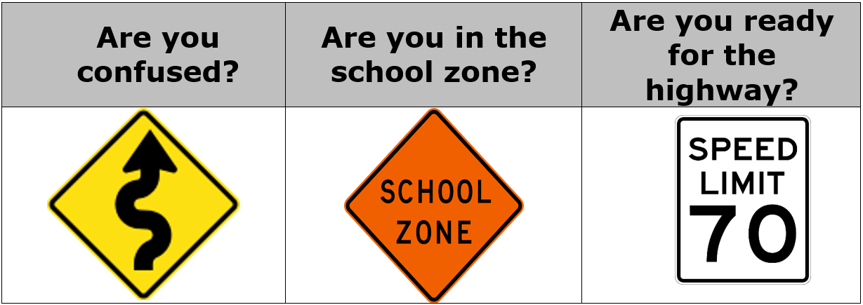
8.7.4 Wrap-Up: Growth Mindset
Consider which sign best represents the road you are on.
Choose the question and sign that best describes your understanding of today’s lesson by putting an asterisk (*) next to the sign that matches.
Briefly explain why you feel this way.
volume 2, pg. 38

